Slide 1


NFP 360 v Affiliates – Insurance
Initial Proposal for Enhancement
June 17, 2014

Slide 2
Agenda
1
Summary of Challenges and Initiative Goals
2
First Phase: Proof of Concept
3
Team
4
Pricing
5
Discussion, Next Steps and Timeline

Slide 3
1 NFP 360 v Affiliates: Our Understanding of Challenges and Goals
CHALLENGES
Poor adoption/usage by Firms
Experience awkward for Firms
Limited workflow automation
Non-standard workflow
Lack of integration into NFP tools
Non-scalable on-boarding
Limited business tracking and insight into the Firm channel
Some difficulty managing and maintaining 360 as a product and its enhancements
KEY GOALS
Address key usability issues
Efficiency of layouts
Opportunity/product selection
Increased standardization of workflow
Greater integration into existing tools BUSINESS: more adoption, usage; improved Firm operational excellence
Shorten on-boarding process with improved tools and process BUSINESS: reduced expense associated with adoption
Improved KPI tracking/reporting BUSINESS: improved 360 insights for promotion and cross-sell
Roadmap and process for identifying and managing enhancements
DESIRED END STATE
Firms experience NFP 360 as a highly useful solution for their sales enablement
Most Firms migrated within 1 year, cost-effectively
Dashboard and reports populated with consistent and reliable data
Governance of change management & related processes

Slide 4
Proposed 3-Phased Strategy*
Phase 3
ADITI can help NFP’s operations by seamlessly transitioning needed enhancement of the NFP 360 Affiliate app as well as on-going maintenance
*draft of current thinking based on limited discovery; we welcome feedback and suggestions
Broker-Dealer +
Phase 2
Incorporation of Broker-Dealer channel/capability (TBD)
Incorporation of Benefits channel improvements (TBD)
On-going off-shore on-boarding process
Issue and enhancement maintenance of NFP 360 vAffiliates
Assistance as needed on NFP 2.0 (TBD)
Delivery of a v1.1
Phase 1
Usability across all pages with adopted approach
Product selection integrations completed
Improved on-boarding process underway
Any re-skinning implemented
Improved workflow configurations completed
Strategic Value
Evaluation/Learning POC
Evaluate use of custom visual force or declarative
Focus on Opportunity/Product selection
Optionally evaluate On-boarding
Optionally evaluate re-skinning and Workflows
0-2 Months
3-6 Months
7 months +

Slide 5
2 Phase One: Proof of Concept
Inputs to-date: team conversation, Sandbox review, CCI report review
Proposed next step: 6 to 8 week scoped effort to solve problems, gain learning, and produce applicable code
Focus on Insurance line of business and opportunity/product selection area specifically
Draft of proposed initiatives for consideration (in priority left to right):
1 Custom Vs. Declarative
2 Product Selection
3 On-Boarding
4 Re-Skinning
5 Workflow Standardization
Evaluate approach to enable some Firm customization while supporting data aggregation
Build more useful product selection experience
Evaluate existing process in greater depth
Create wireframes for specific areas of the experience
Define requirements and implement a set of configuration items from the CCI report
Optional: evaluate integration of existing tools
Build a more automated process using SO API, ETL, Firm reporting process
Consider implementation
CHECKPOINT
Learning and Design
Framework for page development
Delivery of some functional code
Parallel initiatives
Validation
Desired output

Slide 6
POC: 1 Customization Vs. Declarative
1 Custom vs. Declarative
Evaluate approach to enable some Firm customization while supporting data aggregation
Description
Deliverables
Evaluate use of profiles/record type/out-of-box layouts vs. custom visual force pages: how do we make this work for all the Firms?
Validate with Firms and thru generation of limited set of data reports
Evaluate use of ‘Partner Portal'
Design document for dev and delivery
Functional prototype for opportunity experience
UI Framework
Benefit: a scalable design that allows for some variance by Firm while still supporting meaningful data aggregation for NFP corporate

Slide 7
POC: 2 Product Selection
2 Product Selection
Build more useful product selection experience
Option: evaluate integration of existing tools
Description
Deliverables
Re-design current product selection experience by improvement of custom visual force
Optionally evaluate integration of existing tools such as Product Expert
Production-ready code for product selection page
(Optional) Interface specification for integration of tool
Benefit: a more usable product selection experience will add value to the Firms’ experience in collaborating with NFP

Slide 8
POC: 3 On-Boarding
Description
Deliverables
Evaluate Smart Office API for automation of data pulls
Evaluate use of DbAmp or custom tool dev for ETL
Create near real-time reporting/dashboard for Firm data review
3 On-Boarding
Evaluate existing process in greater depth
Build a more automated process using SO API, ETL, Firm reporting process
ETL recommendations/solution
Improved data analysis tools and process for Firms’ response
Benefit: a scalable design that allows for more rapid collaboration in data migration process will substantially shorten the process start-to-finish

Slide 9
POC: 4,5 Additional Improvements
4 Re-Skinning
Create wireframes for specific areas of the experience
Consider implementation
5 Workflow Standardization
Define requirements and implement a set of configuration items from the CCI report
Description
Deliverables
Evaluate benefit of more elegant re-skinned UI vs. improved existing UI
Pick and implement a set of global reusable workflows
Wireframes (possibly some implemented custom page views)
Configured workflows
Benefit: increase elegance and value of app for “sales enablement” of Firms; new UI would clearly communicate “new and improved” to Firms

Slide 10
Validation
1 Customization Vs Declarative
2 Product Selection
3 On-Boarding
4 Re-Skinning
5 Workflow Standardization
Evaluate approach to enable some Firm customization while supporting data aggregation
Build more useful product selection experience
Evaluate existing process in greater depth
Create wireframes for specific areas of the experience
Define requirements and implement a set of configuration items from the CCI report
Option: evaluate integration of existing tools
Build a more automated process using SO API, ETL, Firm reporting process
Consider implementation
Learning and Design
Framework for page development
Delivery of some functional code
Validation
Desired output
Usability:
Light testing/feedback from 2 Firms
Short list of data reports successfully generated
On-boarding validation TBD: (E.g could be an end-to-end pass of a Firm’s data from Smart Office thru ETL and back to Firm reporting interface)

Slide 11
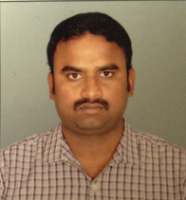
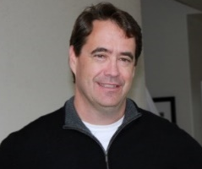
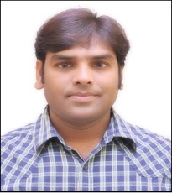




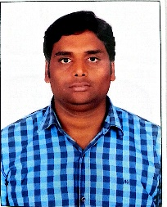

3 Aditi Team
Brian Clift,
Senior Salesforce
Technical Consultant
Venubabu Salesforce Technical Developer
Onkar Kumar
Salesforce Architect
Chandra Kanth
Salesforce Developer
Business Consultant/Analyst TBD

Slide 12
Aditi Team
Onkar Kumar
Senior Salesforce Architect
A multi-skilled Salesforce professional with good all-round Functional and Technical expertise. Extensive experience on Salesforce - sales cloud, service cloud and force.com platform. Recent experience with clients like Sony, Global Foundries, VMWare, Deutsche Bank, Malaysian Airlines. Currently leading a approx. 20 developer Salesforce team at Sony. Led Salesforce center of excellence team at HCL. Strong experience Solution Design for Hi-tech, Banking, Satellite business process with Salesforce And Force.com.
Chandra Kanth
Salesforce Developer
4+ years of administration and development experience on Salesforce.com CRM and Force.com platform. Experience with Salesforce.com developer toolkit including Apex Classes, Controllers and Triggers, Visualforce, Force.com IDE, Migration Tool, Web Services.
Venu Babu
Salesforce Developer
Certified and self‐motivated professional with more than 4 years of experience in SFDC as a Developer . Managing each and every responsibility of gathering project information from clients.Strong Hands on experience in Salesforce CRM solutions and custom applications development on the Force.com Platform including Integration with different system. Consistently receive positive feedback from managers, co-workers and clients.
Brian Clift,
Senior Salesforce
Technical Consultant
Brian Clift has served over the past 20 years as a architect, lead developer, independent consultant and project manager. In the most recent 7 years, Brian has served as a Salesforce.com lead developer, project manager and architect on large, complex and custom projects for companies such as Staples, Hewlett-Packard, Level 3 Communications, Motorola-Mobility, Qualcomm, Citrix and others.
Business Analyst / Consultant TBD
Coming soon…

Slide 13
4 POC Pricing
We will put together pricing once we’ve received some feedback on priorities, scope,
And Budget parameters

Slide 14
5 Next Steps and Timeline
1
Incorporate Feedback
2
POC Proposal with Pricing (by June 20)
3
NFP Sign-off and SOW
4
Schedule project kickoff (target date July 1)

Slide 15
Web | Blog | Facebook | Twitter | LinkedIn

Slide 16
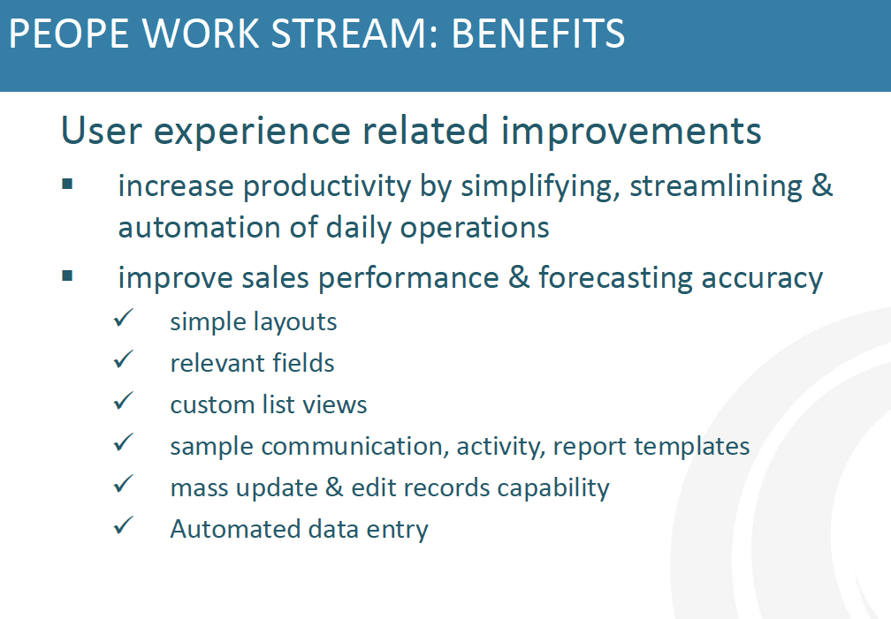
Appendix: CCI Extracts
PEOPLE

Slide 17
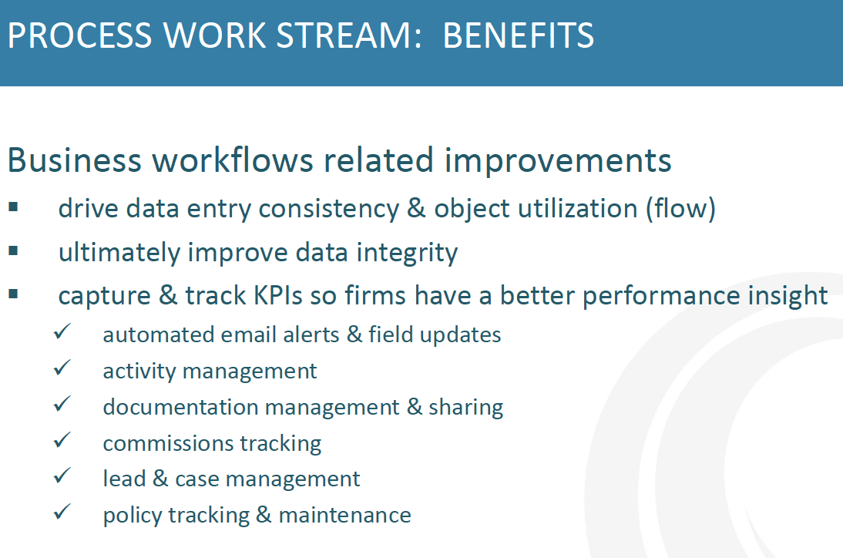
Appendix: CCI Extracts
PROCESS

Slide 18
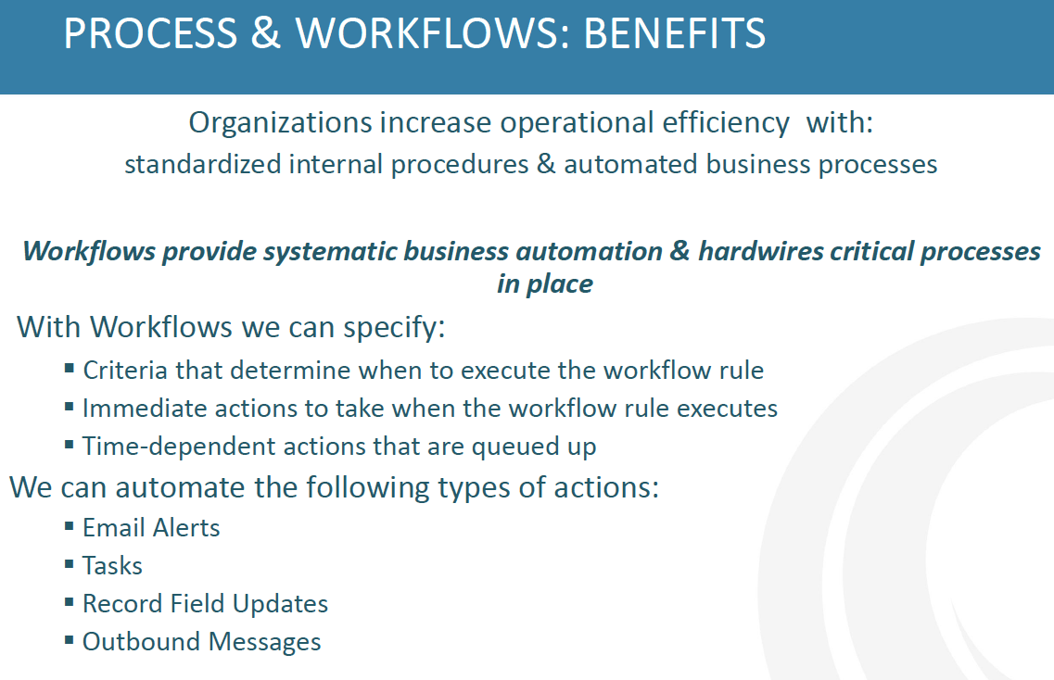
Appendix: CCI Extracts
PROCESS

Slide 19
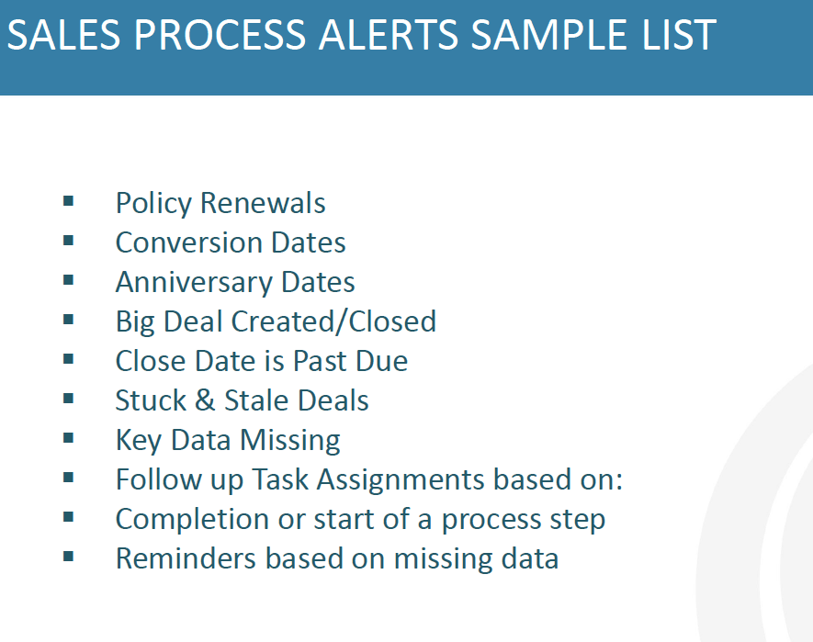
Appendix: CCI Extracts
PROCESS

Slide 20
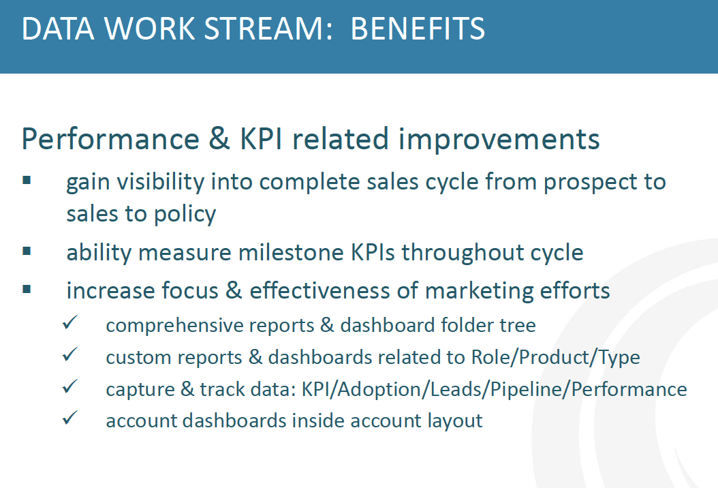
Appendix: CCI Extracts
DATA

Slide 21
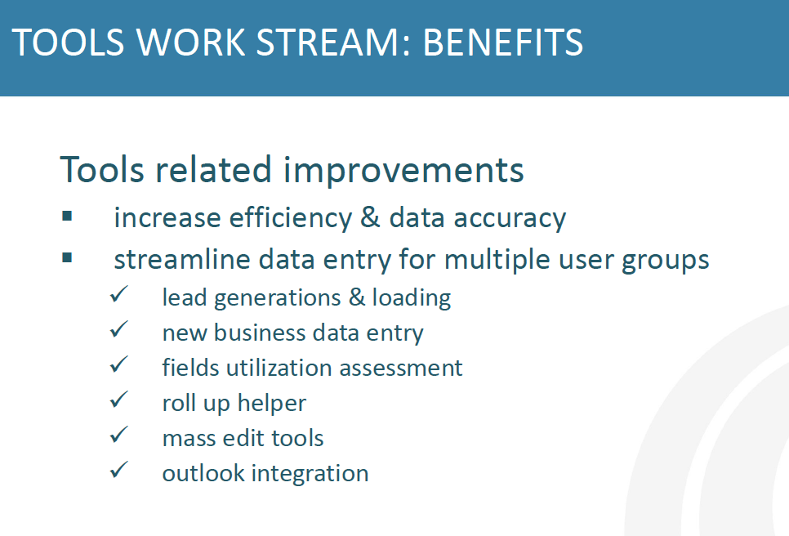
Appendix: CCI Extracts
TOOLS

